Slide 1

Compounding Taxes: Impacts of Disability & Intersectionality
Jennifer Strickland Senior Accessibility Human Centered Engineer
Ronna ten Brink Lead Human Centered Engineer
Co-author not present today: Mariam Chahine
2024 AccessU Tuesday, May 14, 2024, 10:15 am CT, Room Trustee 203

Slide 2
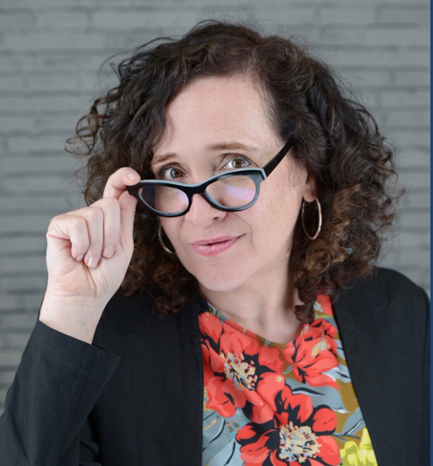
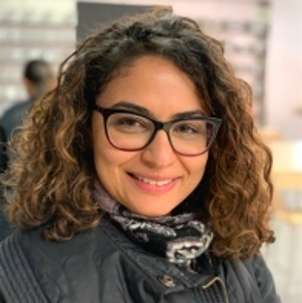
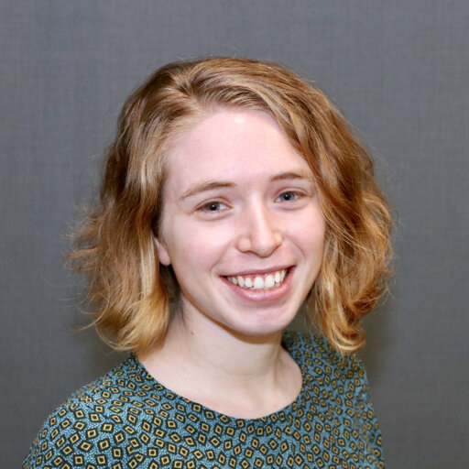
We serve the public interest at The MITRE Corporation supporting several U.S. federal agencies
Jen Strickland they/she
Designer, Developer, Researcher, Strategist, Policy-wonk-in-training, DC
Volunteer with U.S. Digital Response supporting local gov
Dedicated to equitable outcomes for everyone
Master’s in Public Administration student at Syracuse University Maxwell School of Citizenship & Public Affairs
Mariam Chahine she/her
Senior Agile Design Engineer, Boston
Shares a passion for design thinking methods, with a focus on service design with a background in patient advocacy and healthcare management
M.A. in Media Design, Emerson College’s Engagement Lab
Ronna ten Brink she/her
Lead Human Factors Engineer, Boston
Studied Engineering Psychology & Computer Science at Tufts University
Conducts usability and accessibility research and design on various topics and domains including decision-support systems, human-machine teaming, conversational bots, authentication and access management
Teaches on these topics internally and at conferences

Slide 3
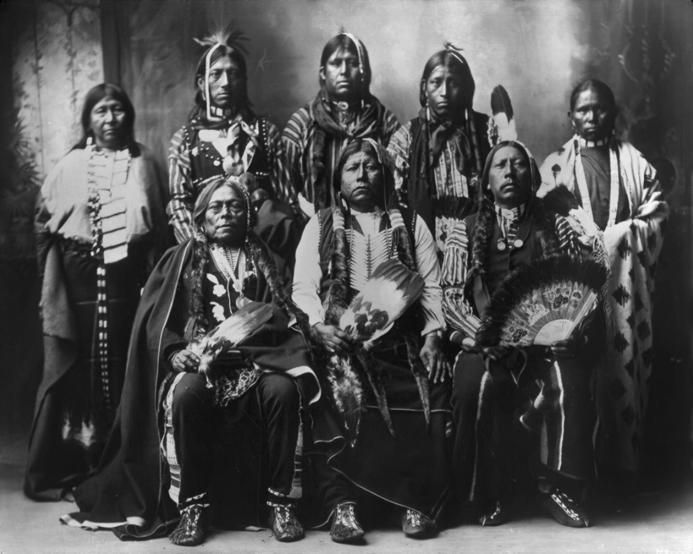
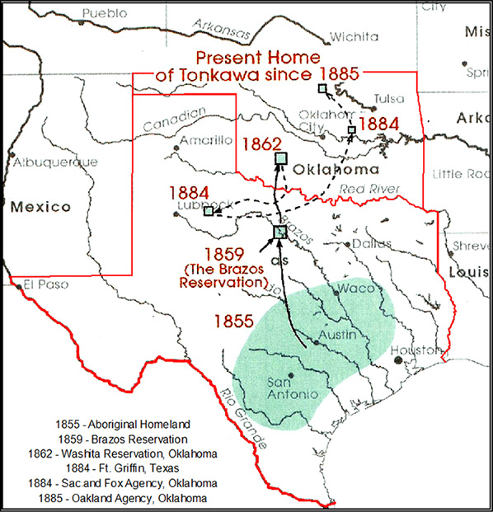
Acknowledgement How can we be in good relationship with Indigenous peoples, with non-human beings, with the land and water?
The original people living in the area now known as Austin and Central Texas are the Coahuiltecan. They built the Alamo. Later, Tonkawa, Comanche, and Lipan Apache arrived. Most of these tribes’ descendents live in Oklahoma and Texas.
Coahuiltecan
Tonkawa
Sana
Lipan Apaches
Comanches
Photograph by Rhinehart in 1898. Standing L-R: Winnie Richards, John Rush Buffalo, William Stevens, John Allen and Mary Richards. Seated L-R: John Williams, Grant Richards and Sherman Miles.
Source: https://tonkawatribe.com/language-culture/history/
Notes:
Sources: https://native-land.ca https://www.youarehereatx.org/indigenous-peoples-in-austin/ https://www.roundrocktexas.gov/city-departments/planning-and-development-services/historic-preservation-2/historic-round-rock-collection/tonkawa-indians/ https://tonkawatribe.com/language-culture/history/ https://www.tshaonline.org/handbook/entries/sana-indians
We’re all in communities that owe their very existence to generations from around the world. Those people lent their hopes, dreams, energy, and pains to creating the history we come from. Some were brought against their will, some left homelands in hope of a better life, and some have been on this land for many generations.
We must acknowledge what has been buried. Without that context, we uphold systemic inequities that leave many in lives of suffering. Please take a moment to consider the many legacies of violence, displacement, migration, and settlement that bring us together. And please join us in uncovering such truths and use such truths to guide your work towards equitable outcomes.

Slide 4



Let’s talk about…
Taxes
Intersectionality
Compounding barriers & benefits
Research approaches
Then end with key takeaways.
© 2024 THE MITRE CORPORATION. ALL RIGHTS RESERVED.

Slide 5

Taxes

Slide 6



Taxes … more than local, state, and federal
Pink
From razor blades and haircuts to girls' toys, women regularly pay more for items and especially services that are nearly identical to those for men but marketed differently
Disability
For people with disabilities, barriers to critical, lifesaving safety net programs are a part of everyday life. Known as “administrative burdens,” roughly defined as any challenge making it difficult to access / maintain assistance for which they otherwise qualify.
Race / Ethnicity
The effects of systemic racism, overt racism, and xenophobia limit opportunities for finance, health, other social benefits.
Notes:
You’ve probably heard of “disability tax” and “pink tax.”
Pink
https://www.dw.com/en/women-getting-ripped-off-in-germany-pink-razors-cost-more/a-41878351
https://www.forbes.com/sites/kimelsesser/2022/12/19/will-californias-new-pink-tax-law-save-women-47-billion-annually/?sh=1deb2a98ff70
Disability
Justin Schweitzer, “How To Address the Administrative Burdens of Accessing the Safety Net” (Washington: Center for American Progress, 2022), available at https://www.americanprogress.org/article/how-to-address-the-administrative-burdens-of-accessing-the-safety-net/.
https://www.americanprogress.org/article/how-dehumanizing-administrative-burdens-harm-disabled-people/
https://endometriosis.net/living/financial-toll
https://www.businessinsider.com/personal-finance/disabled-tax-pay-extra-necessities-2023-4
https://www.glamourmagazine.co.uk/article/the-disability-tax
Race / Ethnicity
https://home.treasury.gov/news/featured-stories/disparities-in-the-benefits-of-tax-expenditures-by-race-and-ethnicity
What Racism Costs Us All. Losavio, Joseph. September 2020. https://www.imf.org/en/Publications/fandd/issues/2020/09/the-economic-cost-of-racism-losavio

Slide 7
Disparity
“Social inequality is characterized by the existence of unequal opportunities and rewards for different social positions or statuses within a group or society. It contains structured and recurrent patterns of unequal distributions of goods, wealth, opportunities, rewards, and punishments.”
—The Sociology of Social Inequality. Crossman, Ashley. April 17, 2018. City University of NY’s Thought & Co.
“…social or economic condition that’s considered unfairly unequal: a racial disparity in hiring, a health disparity between the rich and the poor, an income disparity between men and women, and so on.”
—Merriam-Webster

Slide 8
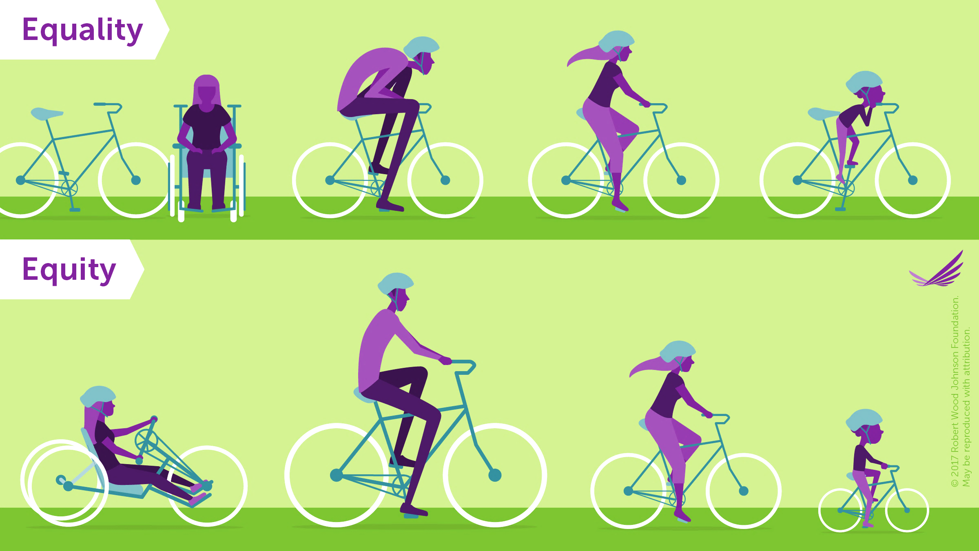
Equality vs Equity, 2017 graphic from Robert J. Wood on Heath Equity
Notes:
2017 graphic from Robert J. Wood on Heath Equity.
Source: https://www.rwjf.org/en/library/infographics/visualizing-health-equity.html

Slide 9

Intersectionality One’s lived experience is greater than the sum of their identities.
Notes:
Intersectionality (or intersectional theory) is a term first coined in 1989 by American civil rights advocate and leading scholar of critical race theory, Kimberlé Williams Crenshaw.
It is the study of overlapping or intersecting social identities and related systems of oppression, domination, or discrimination. The theory suggests that—and seeks to examine how—various biological, social and cultural categories such as gender, race, class, ability, sexual orientation, religion, caste, age, nationality and other sectarian axes of identity interact on multiple and often simultaneous levels.
In other words, intersectional theory asserts that people are often disadvantaged by multiple sources of oppression: their race, class, gender identity, sexual orientation, religion, and other identity markers. Intersectionality recognizes that identity markers (e.g. “woman” and “black”) do not exist independently of each other, and that each informs the others, often creating a complex convergence of oppression. (Leigh Chandler)
https://researchguides.library.syr.edu/fys101/intersectionality
https://www.nationaldisabilityinstitute.org/wp-content/uploads/2020/08/race-ethnicity-and-disability-financial-impact.pdf

Slide 10
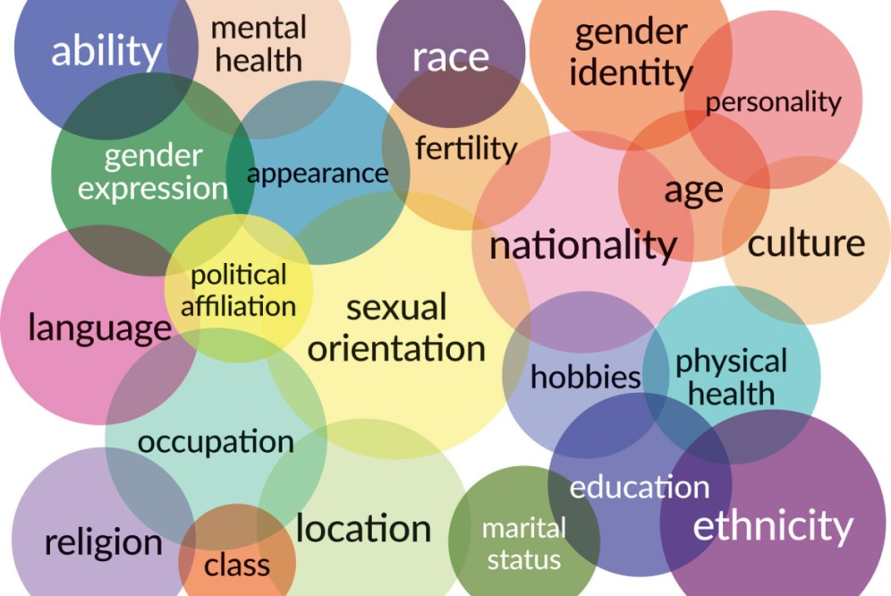
Intersectionality may compound barriers
According to the Center for Intersectional Justice, intersectional identity characteristics may “intersect to create unique dynamics and effects” and may compound barriers to accessing services and impact outcomes.
Notes:
For example, having a disability can often create additional barriers, such as financial considerations and time management considerations.
Source: https://www.intersectionaljustice.org/what-is-intersectionality

Slide 11
Intersectionality statistics on race/ethnicity & disability
Race/Ethnicity | No disability | With disability | % with a disability
American Indian and Alaska Native alone | 3,136,844 | 492,983 | 15.7
Black or African American alone | 39,433,690 | 5,892,163 | 14.9
White alone, not Hispanic or Latino | 189,453,615 | 27,692,494 | 14.6
White alone | 200,003,542 | 28,800,167 | 14.4
Native Hawaiian & Other Pacific Islander alone | 648,525 | 80,808 | 12.5
Two or more races | 41,284,223 | 4,780,216 | 11.6
Hispanic or Latino (of any race) | 62,806,703 | 6,581,811 | 10.5
Some other race alone | 24,217,296 | 2,482,618 | 10.3
Asian alone | 19,585,690 | 1,617,809 | 8.3
328,309,810 people included in this American Community Survey from 2022, representing 13.4% of the civilian non-institutionalized population
Source: U.S. Census Bureau. (2022). American Community Survey 1-Year Estimates (Table S1810).
Notes:
Updated from Andrea Urqueta Alfaro’s work.
https://data.census.gov/table/ACSST1Y2022.S1810?q=S1810:%20Disability%20Characteristics
U.S. Census Bureau, 2022 American Community Survey 1-Year Estimates (Table S1810)

Slide 12

Compounding Barriers & Benefits

Slide 13
Matrix of Domination / Oppression
Social Identity | Privileged Social | Border Social | Targeted Social | -ism
Race | White People | Biracial People (White/Latinx, Black, Asian) | Asian, Black, Latinx, Native People | Racism
Sex | Bio Men | Transsexual, Intersex | Bio Women | Sexism
Gender | Gender-conforming Bio Men & Women | Gender Ambiguous Bio Men & Women | Transgender, Genderqueer, Intersex | Transgender Oppression
Sexual Orientation | Heterosexual | Bisexual | Lesbians, Gay Men | Heterosexism
Class | Rich, Upper Class | Middle Class | Working Class, Poor | Classism
Ability/Disability | Temporarily Able-bodied | Temporary Disabilities | People with Disabilities | Ableism
Religion | Protestants | Roman Catholic (historically) | Jews, Muslims, Hindu | Religious Oppression
Age | Adults | Young Adults | Elders, Young | Ageism/Adultism
Source: Teaching for Diversity and Social Justice, Second Edition from Routledge 2007 and https://www.deanza.edu/faculty/lewisjulie/MOD.pdf
Notes:
Source: Teaching for Diversity and Social Justice, Second Edition by Routledge 2007 from https://www.deanza.edu/faculty/lewisjulie/MOD.pdf

Slide 14
Compounding effects of race & disability on net worth
Household net worth by race / ethnicity and disability status of working-age householder, 2016
There are significant disparities in household net worth by disability status and race.
Black households with a disability have an average net worth of only $1,282.
Latinx households with a disability have a $13,340 average net worth.
In comparison, white households with a disability have a $27,100 average net worth.
Source: National Disability Institute Analysis of U.S. Census Bureau. 2019. Survey of Income & Program Participation Microdata, 2014 Panel, Wave 4.
Notes:
Source: National Disability Institute Analysis of U.S. Census Bureau (2019) Survey of Income and Program Participation Microdata, 2014 Panel, Wave 4. https://www.nationaldisabilityinstitute.org/wp-content/uploads/2020/08/race-ethnicity-and-disability-financial-impact.pdf

Slide 15

Research on the compounding barriers of intersectionality
Complex Dynamics: Disability, Assistive Technology, and the LGBTQIA+ Community Center Experience in the United States Crawford, Kirk; Spiel, Katta; Hamidi, Foad. October 2023. ASSETS ‘23. Study on the experience and barriers faced by LGBTQIA+ people with disabilities in community centers, identified “barriers to accessing and using AT, including social stigma, cost, and limitations in AT design.”
Working at the Intersection of Race, Disability, and Accessibility Harrington, Christina; Moharana, Sanika; Desai, Aashaka; Spencer Ross, Anne; Lewis, Aaleyah; Mankoff, Jennifer. October 2023. ASSETS ’23. Examination of the intersection of race and disability to improve accessibility research, highlighting more work to be done especially continued engagement with representation from diverse communities.
Introduction to Intersectional Qualitative Research Esposito, Jennifer; Evans-Winters, Venus. 2022. Sage Publications. Detailed book on the revolution of qualitative inquiry, including methodologies, analysis, conversational approaches.
Notes:
Sources
Crawford, Kirk; Spiel, Katta; Hamidi, Foad. October 2023. Complex Dynamics: Disability, Assistive Technology, and the LGBTQIA+ Community Center Experience in the United States. ASSETS ‘23.
Harrington, Christina; Moharana, Sanika; Desai, Aashaka; Spencer Ross, Anne; Lewis, Aaleyah; Mankoff, Jennifer. October 2023. Working at the Intersection of Race, Disability, and Accessibility. ASSETS ‘23.
Esposito, Jennifer; Evans-Winters, Venus. 2022. Introduction to Intersectional Qualitative Research. Sage Publications.

Slide 16
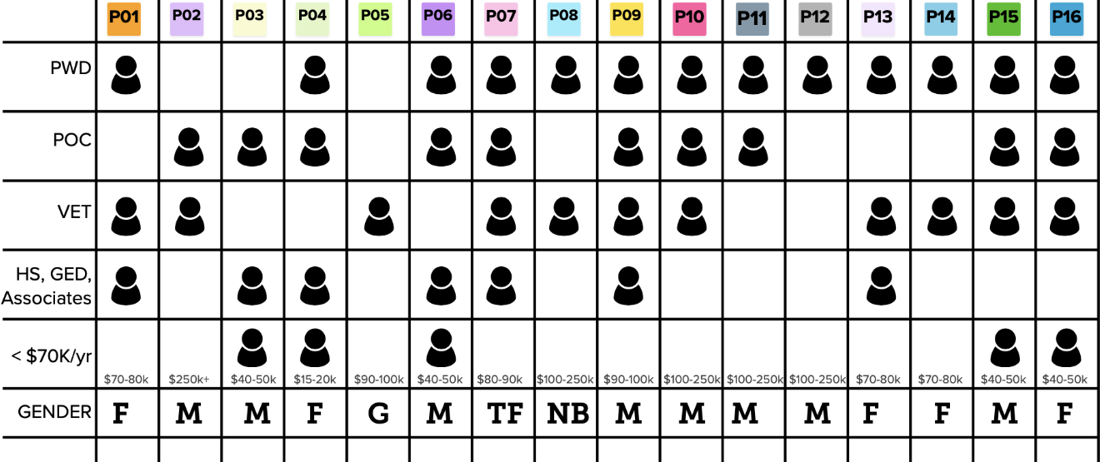
Research Approaches

Slide 17




Lessons from Our Research Design
Category | Description
Cognitive | may range from PTSD, TBI, ADHD, ADD, Autism spectrum, Depression, Anxiety, developmental disabilities, etc.; could require knowing the activity planned before the date as well as live transcript provided
Hearing | may be deaf/Deaf/Hard of Hearing (HoH), may require use of ASL translator, text, or other
Mobility | may use specialized keyboard, or another technology
Vision | may use screen reader or magnifier
Research Goal
Inform broader IRS strategies to best serve diverse taxpayers, particularly taxpayers with disabilities.
Research Questions
Overall, discover challenges and opportunities around IRS services for diverse taxpayers, particularly taxpayers with disabilities.
While recruiting People With Disabilities (PWD), we also seek to understand how usability may be impacted by various intersectional identity characteristics, as an enhanced information-gathering while focusing on PWD.
Notes:
“…equity means recognizing that we do not all start from the same place and must acknowledge and make adjustments to imbalances. The process is ongoing, requiring us to identify and overcome intentional and unintentional barriers arising from bias or systemic structures.” (https://www.naceweb.org/about-us/equity-definition/)
“equity tax” (akin to disability tax) refers to the time, money, and energy (burdens, barriers, hardships, etc.) that impact an individual’s experience and outcome.
In our systems we might pay lawyers, doctors, and businesspeople more, thinking that their calendars are hard to get time on and they are paid (worth) more per hour.
In equitable practices, we see to acknowledge, adjust, and overcome barriers from systemic inequities. For example, a person may work a minimum wage job and be happy for the extra money from participating in research, but that is time away from caring for their children or elders. A disabled person with cognitive considerations may need to endure a migraine or spend the rest of the day in bed if they participate.
Having these traditionally excluded perspectives represented in research so that organizations may learn from them is especially valuable to civic systems tasked with serving all people not just those who can afford to participate.
Paying everyone the same rate is one solution, as $150 means more to the 'barriered' person than it does to the privileged, and I understand that as a good way of being fair. It's just that we may find some individuals that experience greater barriers, and we may need to accommodate, be it through more time + more incentive, or breaking up sessions into more than one time as well as more incentive.
We won't know until we see who we are able to recruit. My sense is that many of the most impacted won't be able to find the recruiting opportunities, just as one participant of immigrant parents said that her parents wouldn't participate or trust enough to give honest answers.

Slide 18

Recruiting Recruiting targeted an intersectional pool of participants.
We aimed to speak with as many people with disabilities as possible. At a minimum, we sought 5 participants from each disability category. Participants may have one or more disability.
Other characteristics noted, for example: age, gender, race or ethnicity, education, disability diagnosis, use of assistive technology (AT), Veteran, filing status, income, and if moved to U.S. for the first time within last 5 years, except from Canada.
Recruiting for intersectional characteristics and gathering related demographic information enabled us to discover how characteristic-related purpose, thinking style, or experience may impact usability and to provide recommendations to increase usability for all users regardless of user characteristics.

Slide 19
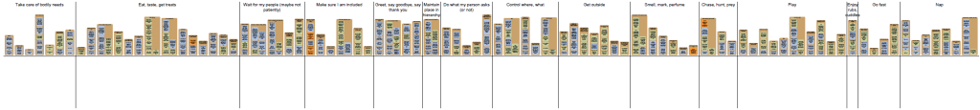
Tools
List of Tools
Conversation Guide for interview questions and script
Internet connection
Conferencing software to record and transcribe interviews
Mental Model Diagram Generator
Information Capture
Interviews are captured using automatic transcription, to provide a verbatim record and avoid unintentional bias inherent in an assigned notetaker determining what is important to note.
Each transcript is later cleaned to remove mistakes in the transcription, address unintelligible utterances, investigate unknown terminology, and prepare for analysis.
Source: https://indiyoung.com/mental-model-diagram-generator/

Slide 20
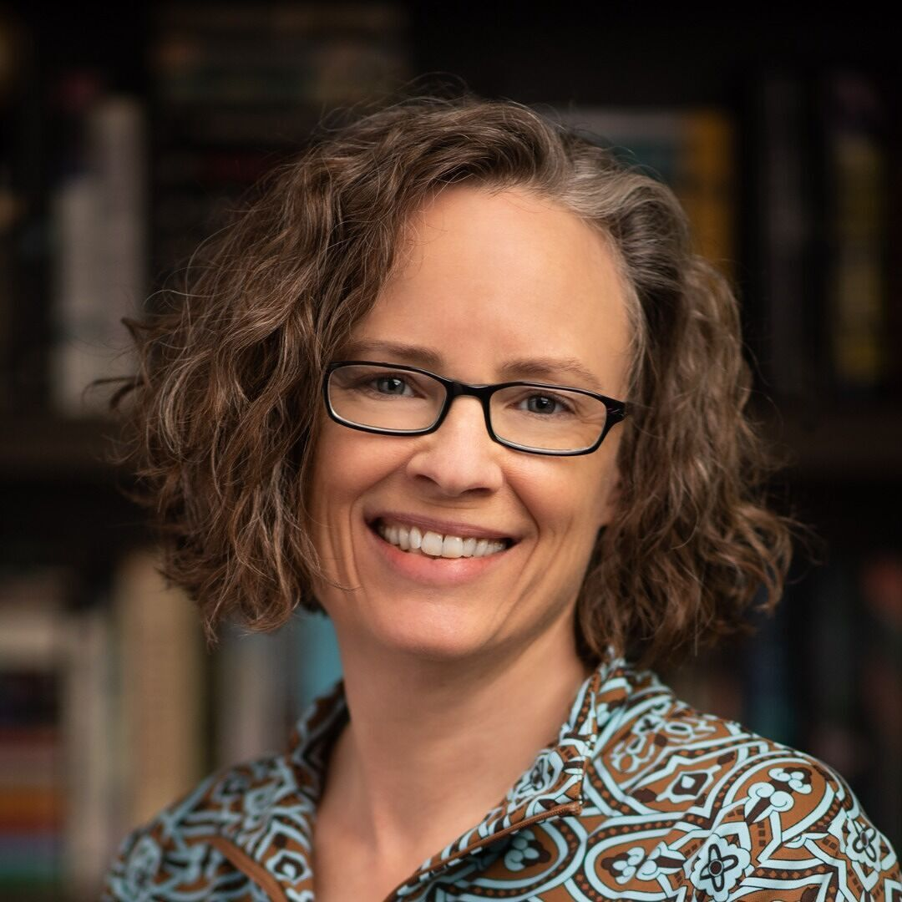
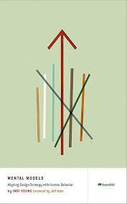
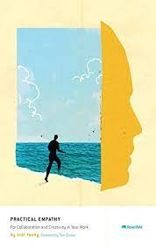
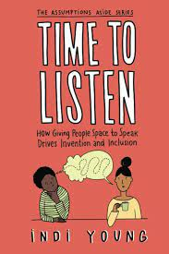
Methodology Semi-structured Interview + Indi Young’s “Listening Sessions”
Listening sessions resemble unstructured interviews.
In a listening session the researcher doesn’t take notes, they record the conversation, so they can pay rapt attention to the participant, noticing if the participant is at interior cognition or not and prompt them there if needed.
The researcher focuses on building genuine trust and helps the participant feel comfortable being candid.
The goal of listening sessions is to explore the purpose of the participant, looking for inner thinking, reactions, and guiding principles.
Source: https://indiyoung.com
Notes:
Listening sessions resemble unstructured interviews. In a listening session the researcher doesn’t take notes, they record the conversation, so they can pay rapt attention to the participant, noticing if the participant is at interior cognition or not and prompt them there if needed. The researcher aims to build trust and help the participant feel comfortable communicating candidly. The goal of listening sessions is to explore the purpose of the participant, looking for inner thinking, reactions, and guiding principles. This process seeks to identify thinking styles, which are similar to commonly used personas but without the emphasis on demographics. Thinking styles are used to cultivate cognitive empathy and awareness, to better serve the spectrum of human experience.
Resources
Young, Indi (2015). Practical Empathy: For Collaboration and Creativity in Your Work. Rosenfeld Media. ISBN-13: 978-1933820484
Young, Indi (June 17, 2022). Time to Listen. Indi Young Books. ISBN-13: 978-1944627119
Young, Indi (2018). Why Problem Space. https://indiyoung.com/explanations-problem-space/
Young, Indi (2018). Listening Deeply. https://indiyoung.com/explanations-listening/
Young, Indi (2018). Listening Deeply. https://medium.com/inclusive-software/listening-deeply-fe55ac43bd32
Demo Listening Sessions https://indiyoung.com/demo-listening-sessions/
Huang, Linde (August 2, 2019). It’s not an interview, it’s a listening session. UX Collective. https://uxdesign.cc/its-not-an-interview-it-s-a-listening-session-c379c0043938
Young, Indi (February 17, 2015). A New Way to Listen. A List Apart. https://alistapart.com/article/a-new-way-to-listen/
An overview of listening sessions, and opportunity to dive deeper into a paid course. Fluid Hive Podcast. https://fluidhive.com/dt101-64/

Slide 21
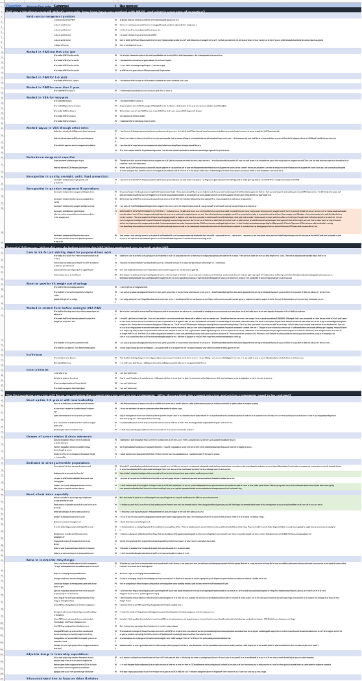
Research Analysis
The cleaned transcript is processed using open coding where each phrase is summarized for conciseness and clarity within a large spreadsheet.
There are multiple passes at coding as summaries reveal themes.
Summaries are then “combed” or grouped into similar themes, then further filtered into insights.
This spreadsheet is used to generate mental model diagrams which capture insights and can then be used to identify opportunities.
In future research session analysis continue to add to the spreadsheet to monitor insights that can be difficult to glean in smaller studies, since recruiting for intersectionality takes time.

Slide 22
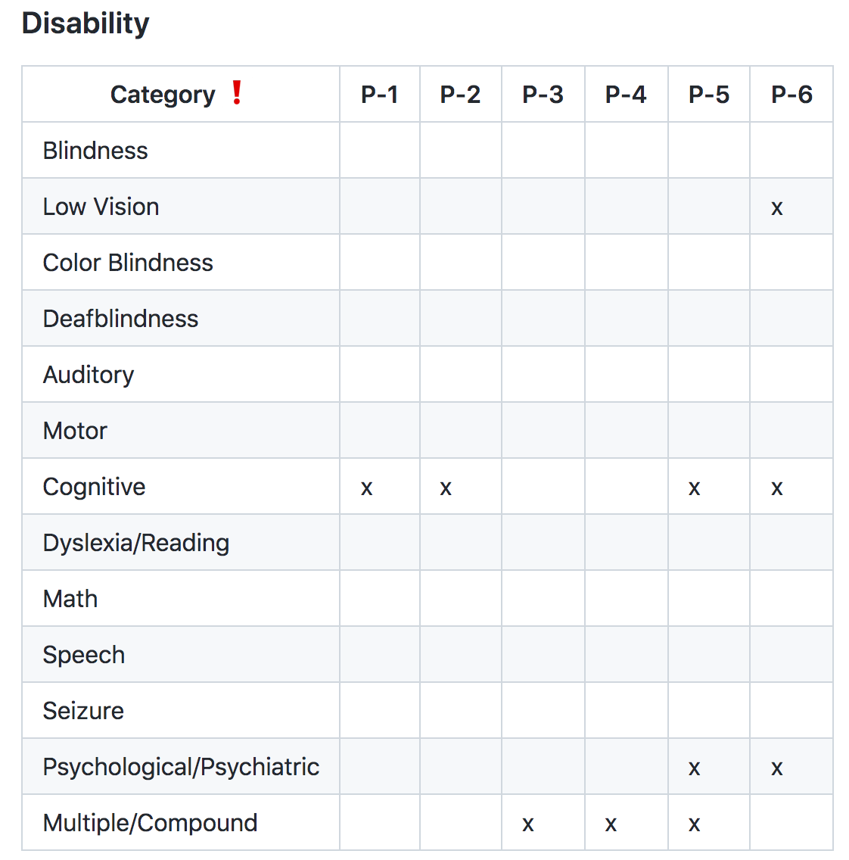
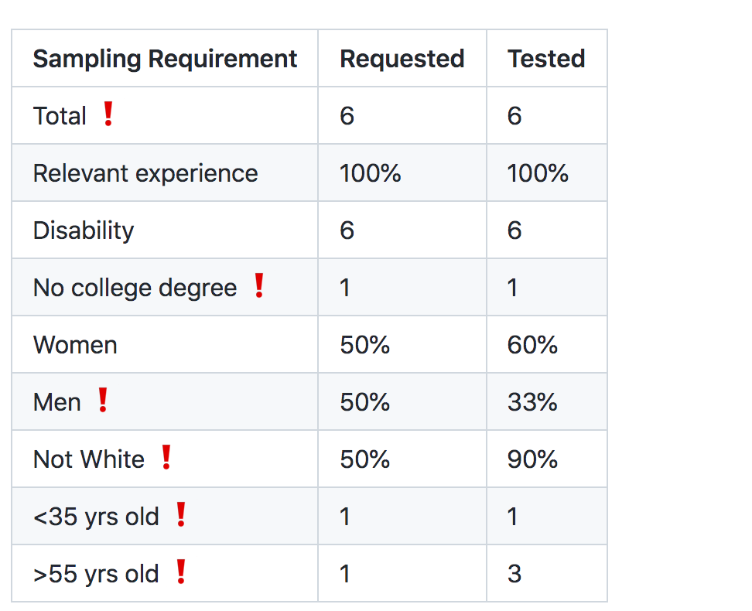
Gaps Analysis A document outlining risks identified for research findings based on a limited pool of participants and limited scope
Notes:
Sasha Costanza-Chock’s Design Justice: Community-Led Practices to Build the Worlds We Need

Slide 23
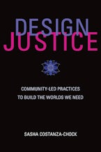
Design Justice is…
a framework for analysis of how design distributes benefits and burdens between various groups of people.
Design justice focuses explicitly on the ways that design reproduces and/or challenges the matrix of domination (white supremacy, heteropatriarchy, capitalism, ableism, settler colonialism, and other forms of structural inequality).
Design justice is also a growing community of practice that aims to ensure a more equitable distribution of design’s benefits and burdens; meaningful participation in design decisions; and recognition of community-based, Indigenous, and diasporic design traditions, knowledge, and practices.
— Sasha Costanza-Chock, Design Justice
Notes:
Our team explored compounding taxes — encountering many barriers and increased impact — in research for the U.S. Internal Revenue Service (IRS).
Elevate your research practices to consider intersectionality, reduce bias, and better serve human purpose.
The IRS Office of Online Services (OLS) Inclusive Design Strategy aims to build design capabilities and research practices which include and value the voices and needs of historically under-researched underserved taxpayer groups.
This research enabled the IRS to deliver services aligned with a variety of identified taxpayer needs.
Discover how characteristic-related purpose or experiences may impact usability, then provide recommendations to increase usability for all users regardless of user characteristics
Attendees will learn techniques:
Researchers: employ equitable recruiting practices, assess intersectional data, novel interview techniques to reduce bias, deliver insights that are actionable and prioritize people and purpose
Designers: improve experiences through consideration of intersectional needs
Strategists: assess compounding user needs and prioritize services that reduce barriers
Everyone: see that humans are gems — disability may be one facet to consider of multi-faceted intersectionality

Slide 24


Key Takeaways
Taxes impact people everyday in ways beyond income, sales, property, and such. These taxes, disparities, and barriers compound in layers of impact for intersectional identities.
We can learn a lot about how these impacts affect the usability and outcomes for the people using the services we design.
Through thoughtful qualitative research, patience, and open minds we can create an equitable world (that I dream of).

Slide 25
Thank you!
Any questions?
Jennifer Strickland, jstrickland@mitre.org
Ronna ten Brink, rtenbrink@mitre.org
Mariam Chahine, mchahine@mitre.org

